Slide 1
ARD
Autonomous Response Drone
A1
Ali Baqar – alinbaqar@gmaill.com
Anahit Sarao - anahitsarao@gmail.com
Maxwell Cheshier - maxcheshier@gmail.com
Brian Josefowicz - brian.josefowicz@sjsu.edu

Slide 2
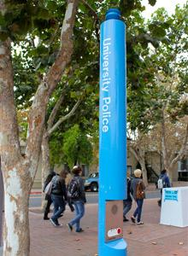
Background
What is the point of a Car Alarm?
The current most effective way to get first response on a college campus is to utilize the panic button towers
Average response time for police is 4 to 5 minutes
The objective is to be able to deploy a police drone which can do audio and video monitoring.
Source: http://www.sjsu.edu/police/pics/police-parking-website/220-width-three-column-right-columns/blue-light-phone-03.jpg
Notes:
anahit

Slide 3
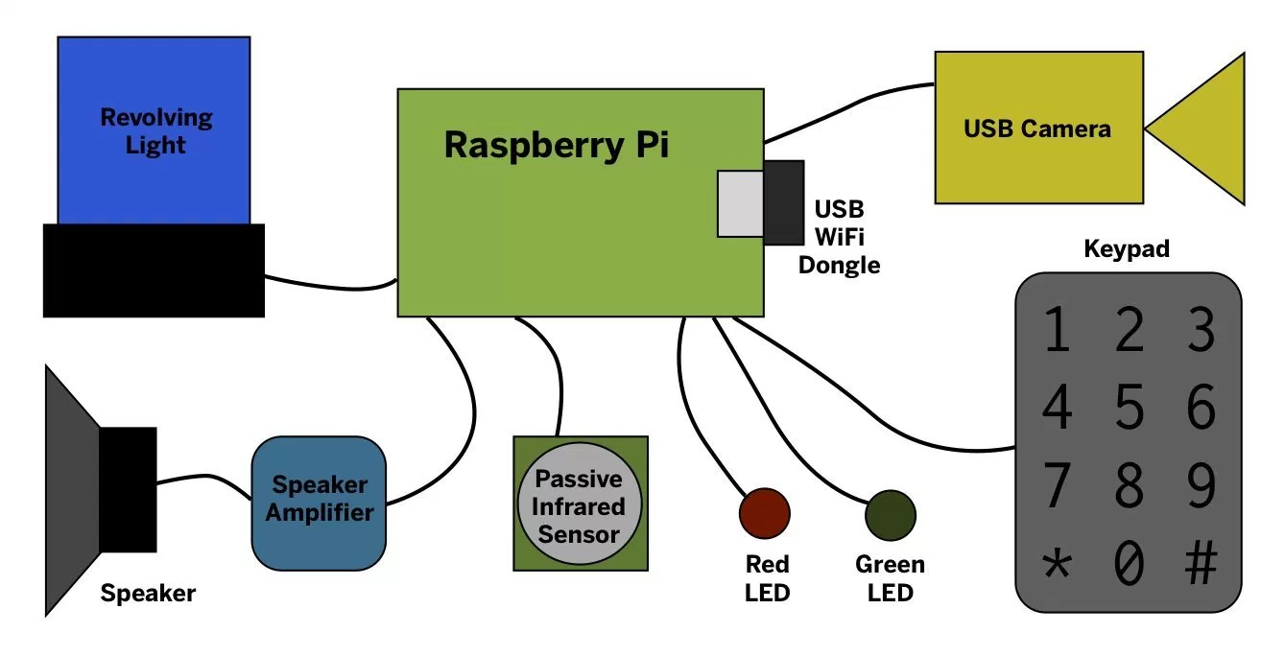
Challenges
The biggest challenge of this project is incorporating the drone with the security pillars
We will need to incorporate a feature in sync with the pillar when the panic button is pressed that will signal the drone to respond
Additionally, programming the drone to autonomously reach its destination will require features such as computer vision and machine learning
Object avoidance
Trees
Buildings
People
GPS Routing
Notes:
anahit

Slide 4
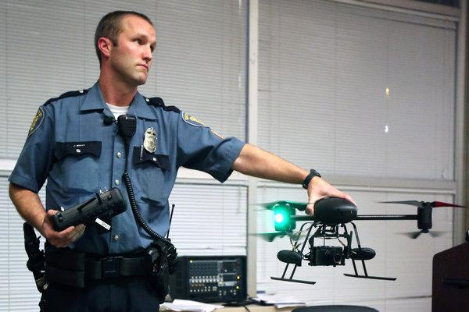
Existing Solutions
Currently, police in California and Texas utilize drones in order to aid them in apprehending criminals (recode.net, 2017)
However, they utilize their drones manually as opposed to autonomously
Additionally, our drone is not a replacement to a police officer but an addon to the police arsenal as a first response and deterrent solution
Source: http://graphics8.nytimes.com/images/2013/02/16/business/Drones/Drones-articleLarge.jpg
Notes:
-Max

Slide 5
Goal and Approach
The goal of this project is to provide a tool which can provide safety for students
The drone will be able to act as a first responder and arrive before police can arrive and will seek to deter any criminal or harmful behavior
We will incorporate the call command feature with the security poles to summon the drone
Example Launch and Return
Button press acknowledged
Nearest drone alerted
Drone begins bootup and self diagnostics
If diagnostics fails second nearest drone is alerted and process restarts
Drone launches to location
Drone returns to location
Video and audio are backed up and logged into central datacenter
Notes:
-Max

Slide 6
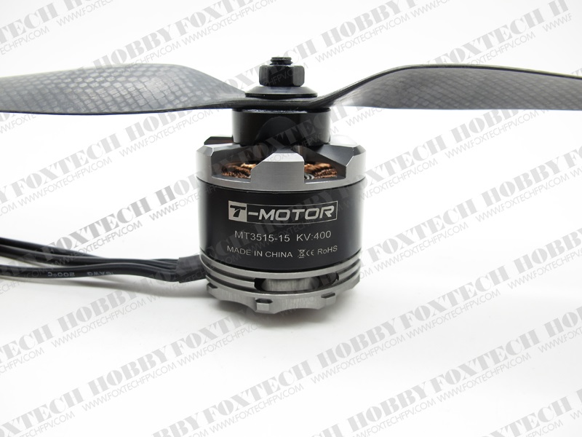
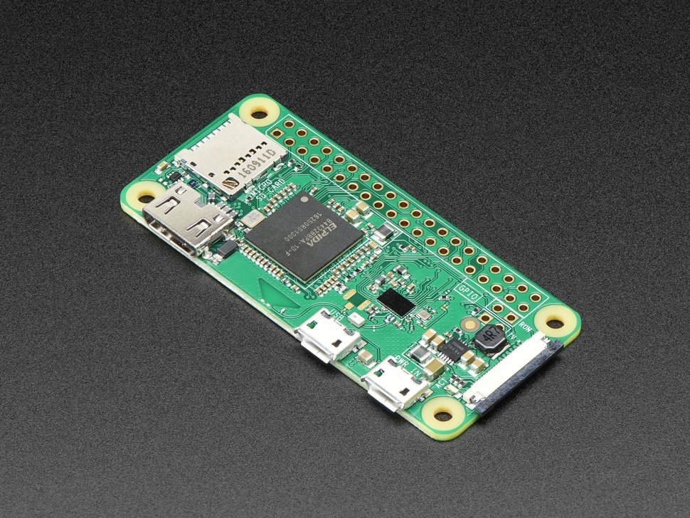
Parts To be Used
We will need to construct a frame
4 motors, 4 ESC’s (electronic speed controller), propellers
Battery Monitoring system and battery
Wifi key and USB key
Raspberry Pi and Raspberry Pi camera
Custom Code
Motor 167 Kv
Raspberry Pi Zero W
Notes:
-Max

Slide 7
Technical Background
4 students with 4+ years of computer engineering study experience each
2+ years of Formula SAE experience - Spartan Racing Electric
Avionic Systems Experience
Combined 4 Years of Industry Coding Proficiency
Notes:
ali

Slide 8
Timeline
Analysis -- June 7th - June 21st
Research, Discussion, Documentation
Design -- June 21st - July 5th
Design circuit diagrams, software design, design specifications
Write basic pseudo-code for modules
Development -- July 5th - July 19th
Develop System modules, Integrate different parts
Testing -- July 19th - August 11th
Perform System Testing
Document Issues Found
Notes:
ali

Slide 9
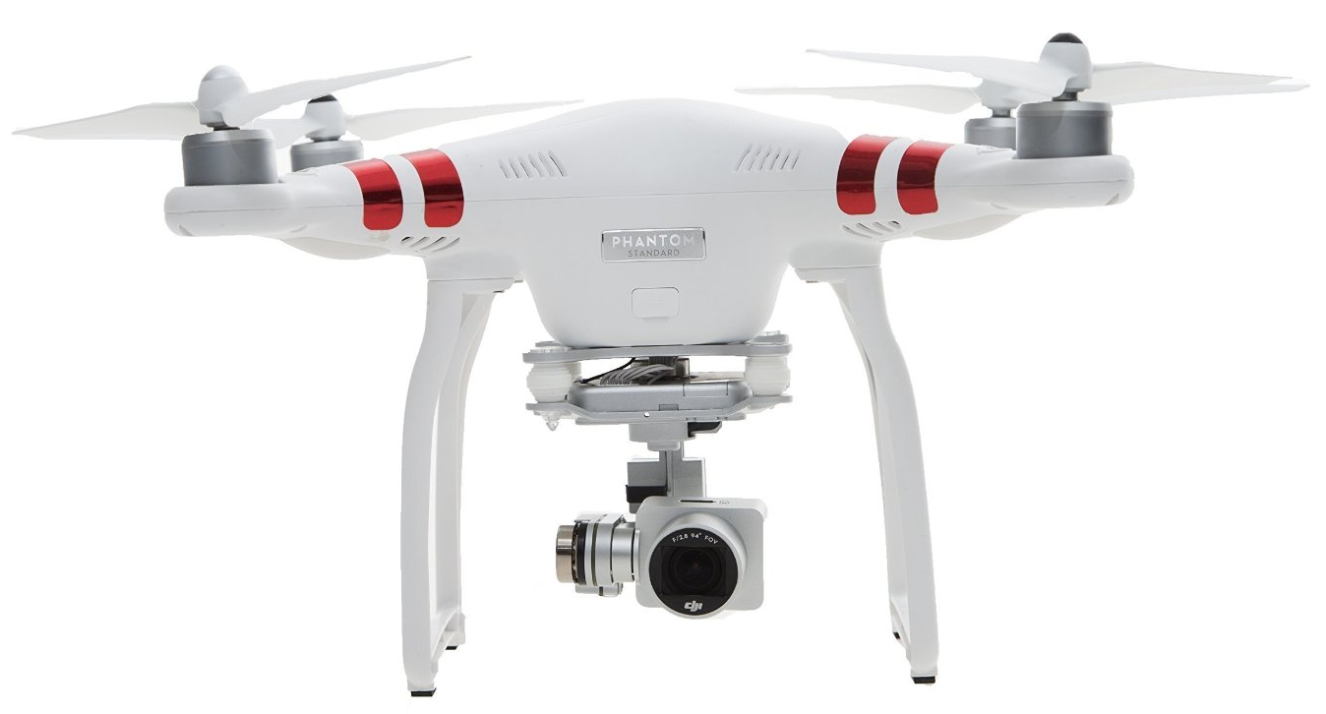
Deliverable
The deliverable will consist of an autonomous drone
The drone will have the ability to fly to a location mapped by GPS
The drone will be equipped with lights, camera, and sirens
It will be built using the Raspberry Pi Zero W Microcontroller with custom code
Source: https://images-na.ssl-images-amazon.com/images/I/71Ao-WrjMDL._SL1500_.jpg
Notes:
ali

